Slide 1















FileBot:
Your AI Assistant for Content

Slide 2

AGENDA
Abstract
Introduction
Advantages
technology used
Working of Filebot
conclusion

Slide 3

Abstract
This is friendly AI assistant! It analyzes documents, creating clear summaries. Imagine having a conversation with your files! Ask questions, seek details, or get a general overview. It uses the file's content to answer in a conversational way, making information retrieval a breeze.
No matter if you're a student researching papers or a busy professional needing quick report summaries, It's user-friendly interface makes it perfect for everyone. It unlocks the power of AI for content management, fostering a new era of interactive information access and understanding.

Slide 4
01.
FileBot analyzes documents & lets you chat for summaries, details, or overviews.
Introduction
02.
Students or professionals, FileBot's user-friendly interface makes it perfect.
Great project presentations can inform, persuade, and excite your audience about your work. FileBot can assist you throughout the process, from structuring your content to crafting a compelling delivery.
Students or professionals, FileBot's user-friendly interface makes it perfect.
03.

Slide 5




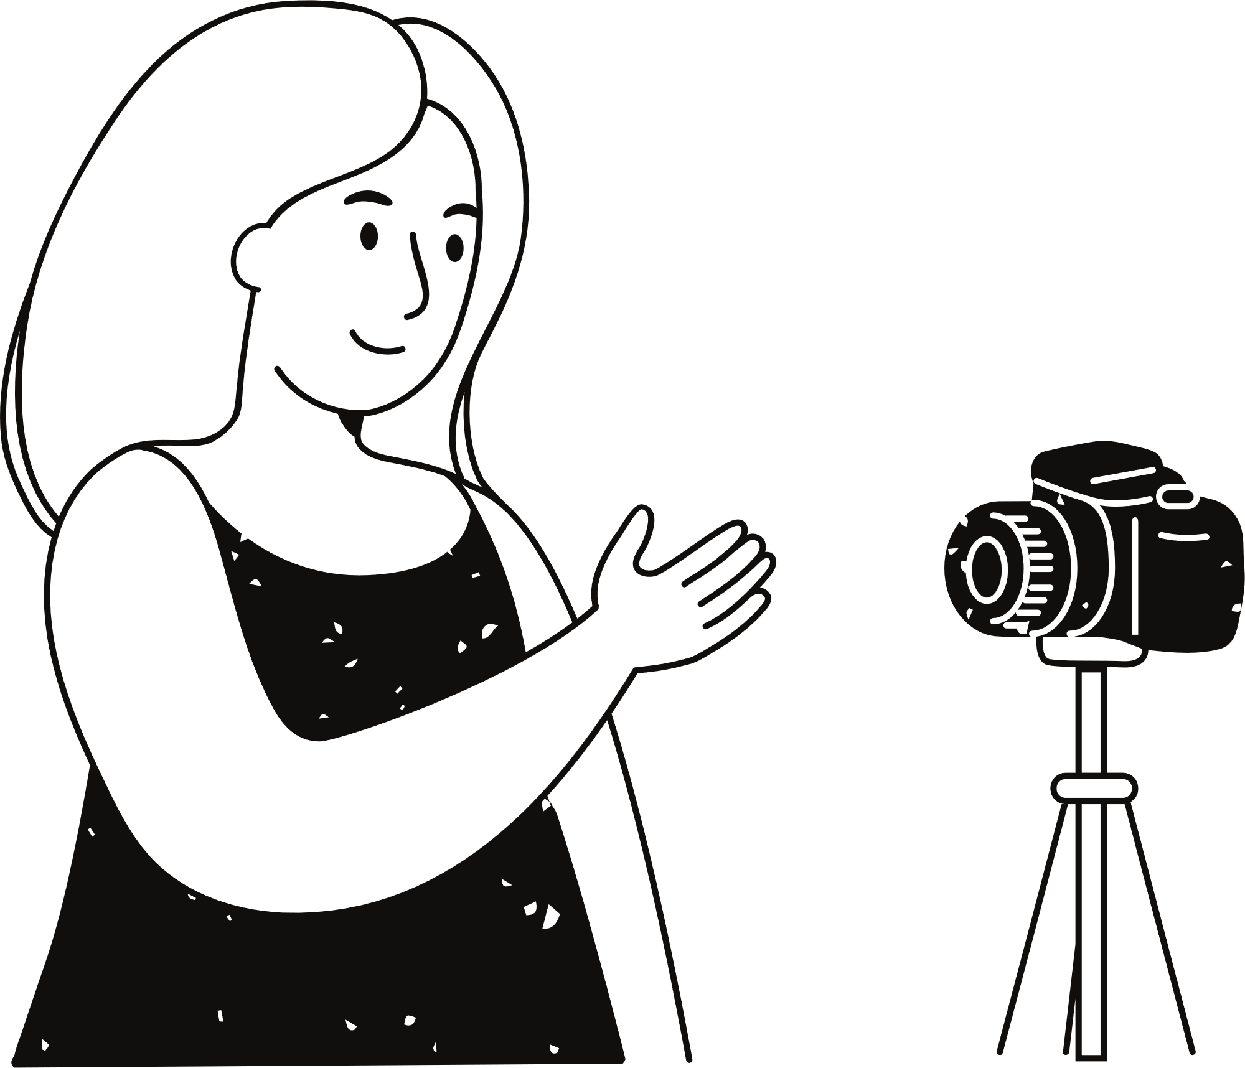
Increased Efficiency:
Enhanced Clarity and Conciseness:
FileBot automates tasks like research, data integration, and slide deck creation, saving you significant time and effort.
FileBot helps you present complex information in a clear and concise way through data visualization and well-structured content.
ADVANTAGES
Improved Quality:
Overall Impact:
FileBot can help you brainstorm stronger ideas, craft a compelling narrative, and design visually appealing slides, leading to a more impactful presentation.
By leveraging FileBot's capabilities, you can create a professional and impactful presentation that effectively communicates your project and captivates your audience.

Slide 6

technology used:
streamlit
langchain
LangChain is a powerful Python library designed to streamline the development of applications that utilize Large Language Models (LLMs). It simplifies the process of building AI-powered tools by providing pre-built components and functionalities.
Streamlit is a free and open-source Python library designed specifically to make creating web apps for data science and machine learning a breeze.
llama2
tempfile
Llama2 in Python refers to interacting with the Llama2 large language model (LLM) developed by Meta AI. Llama2 itself isn't a direct Python library, but you can use Python to interac
The tempfile module in Python is all about creating temporary files and directories. These temporary files are useful for various scenarios where you need a place to store data temporarily during your program's execution.

Slide 7

Working of Filebot
Imagine a virtual sidekick that helps you summarize and extract key points from your local documents. This Python-powered chatbot utilizes cutting-edge tools like Streamlit for a user-friendly interface, Langchain to manage the workflow, and the powerful Llama2 language model for summarizing your content.

Slide 8
conclusion
Leverage the power of AI to transform your local files into readily digestible content. This Python chatbot, armed with the summarizing prowess of Llama2 and the user-friendly interface of Streamlit, streamlines your workflow and unlocks valuable insights hidden within your documents. Whether you're tackling lengthy reports or condensing research papers, this AI assistant becomes your secret weapon for maximizing your productivity and extracting the essence of your local content.

Slide 9
Thank you very much!

